Slide 1
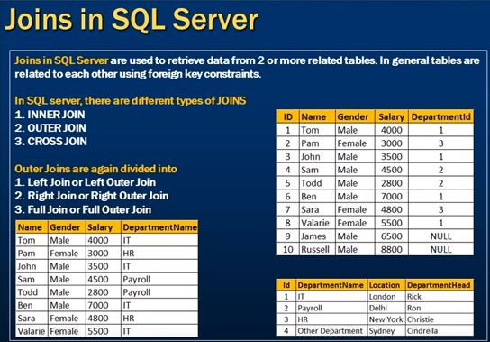

Slide 2
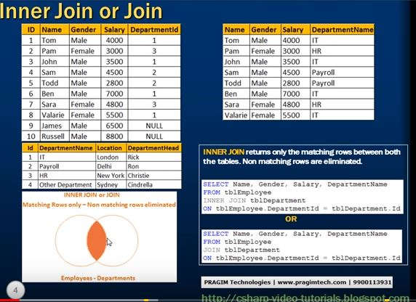

Slide 3
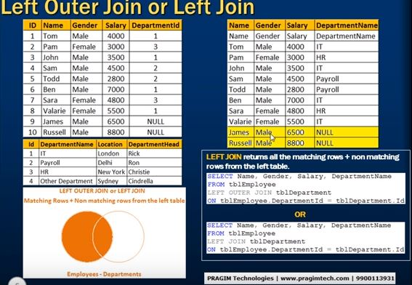

Slide 4
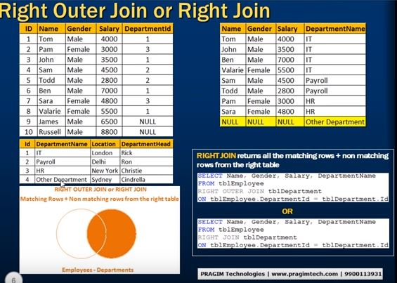

Slide 5
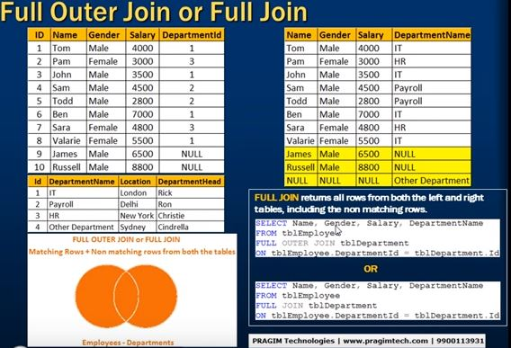

Slide 6
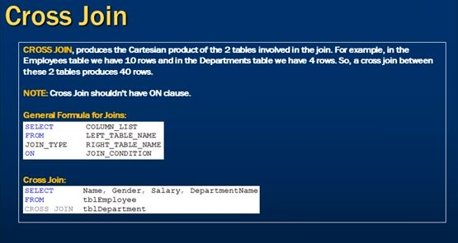

Slide 7
Concatenating data from table columns
Create an English sentence by joining string values and column data.
Select ‘Account number’||ACCT_NO||’was introduced by’||INTRO_CUST_NO||’at branch’||BRANCH_NO “Accounts opened” from ACCT_MSTR;
Result:
Accounts opened
-----------------------------------------------------------------------------
Account number SB1 was introduced by C1 at branch B1
ACCT_NO | INTRO_CUST_NO | BRANCH_NO
SB1 | C1 | B1

Slide 8
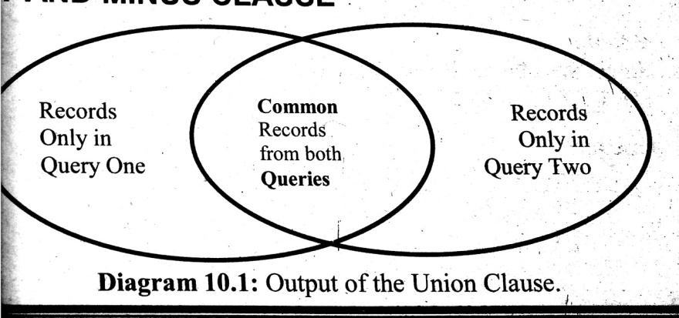
UNION clause
Multiple queries can be put together and their output can be combined using UNION clause.
UNION clause merges the output of two or more queries into a single set of rows and columns.
While using UNION clause the number of columns and the data type must be identical in the columns used in the SELECT statement

Slide 9


Slide 10
Example for UNION clause
Employee table:
Customer Table:
List the employees and customers whose location is chennai
Query:
Select name,location from emp where location=‘Chennai’
UNION
Select name,location from cust where location=‘Chennai’;
Empno | name | Location
E101 | Mandar | Chennai
E102 | Lokesh | Delhi
E103 | Namitha | Chennai
E104 | Neha | Pune
Custno | name | Location
C711 | Akash | Chennai
C712 | Namitha | Bengaluru
C713 | Neha | Chennai

Slide 11
Output
name | Location
Mandar | Chennai
Namitha | Chennai
Akash | Chennai
Neha | Chennai

Slide 12
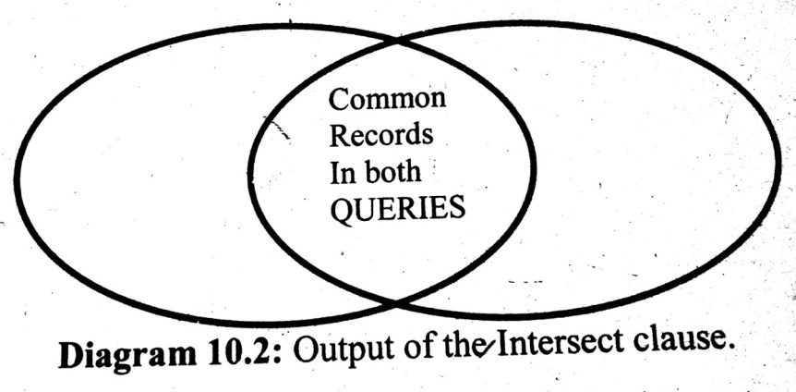
INTERSECT Clause
INTERSECT clause outputs only the rows which are common in both the queries.
The no of columns and data type of columns used in the queries should match.

Slide 13


Slide 14
Example for INTERSECT clause
ACCT_DETAILS:
List the customers who are having both SB and FD accounts.
Query:
Select Custno from ACCT_DETAILS where ACCT_TYPE=‘SB’
INTERSECT
Select Custno from ACCT_DETAILS where ACCT_TYPE=‘FD’;
Custno | ACCT_TYPE
C101 | SB
C102 | SB
C103 | FD
C104 | SB
C102 | FD
C101 | FD
C105 | SB

Slide 15
Output
Custno
C101
C102
C104
C105
Custno
C101
C102
Custno
C103
C102
C101

Slide 16
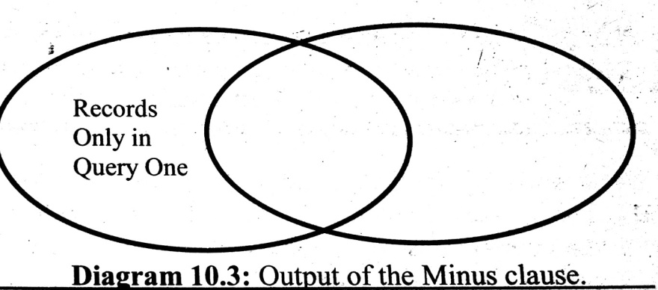
MINUS clause
MINUS clause outputs the rows produced by the first query, after filtering the rows retrieved by the second query
The number of columns and the data types of the columns being selected by the SELECT statement in the queries must be identical.

Slide 17


Slide 18
Example for MINUS clause
ACCT_DETAILS:
List the customers who are having SB but not holding FD accounts.
Query:
Select Custno from ACCT_DETAILS where ACCT_TYPE=‘SB’
MINUS
Select Custno from ACCT_DETAILS where ACCT_TYPE=‘FD’;
Custno | ACCT_TYPE
C101 | SB
C102 | SB
C103 | FD
C104 | SB
C102 | FD
C101 | FD
C105 | SB

Slide 19
Output
Custno
C101
C102
C104
C105
Custno
C104
C105
Custno
C103
C102
C101

Slide 20
Security Management Using SQL
Oracle provides security features to safeguard the information stored in the database.
Depending on a user’s status and responsibilty DBA can assign appropriate rights on the Oracle resources.
The rights that allow the use of some or all of Oracle’s resources on the server are called privileges.
The owner of oracle’s object can give permission to other users to access that particular object and it is called granting of privileges.
Privileges once given can be taken back by the owner of the object and it is called revoking of privileges.

Slide 21
Granting privileges using the GRANT statement
Syntax:
GRANT object privileges
ON objectname
TO username
[WITH GRANT OPTION];
Object privileges-ALTER, DELETE,INSERT,SELECT,UPDATE
With grant option – allows the user who got the privilege is allowed to grant privilege to some other user.

Slide 22
Example 1:
Grant the user Sharan all data manipulation permissions on the table EMP_MSTR.
GRANT ALL ON EMP_MSTR TO Sharan;
Example 2:
Give the user Mona permission to only view and modify records in the table CUST_MSTR
GRANT SELECT,UPDATE ON CUST_MSTR TO Mona;
Example 3:
Give the user Russel all data manipulation on ACCT_MSTR along with an option to further grant permission on ACCT_MSTR to other user.
GRANT ALL ON ACCT_MSTR TO Russel WITH GRANT OPTION;

Slide 23
Revoking permissions using the REVOKE statement
Syntax:
REVOKE object privileges
ON objectname
FROM username;
Example:
Take back the Delete privilege from Sharan on table EMP_MSTR.
REVOKE DELETE ON EMP_MSTR FROM Sharan;

Slide 24
END OF UNIT III

